Slide 1
Module 7: Authentication, Authorization, and Accounting (AAA)
Networking Security v1.0
(NETSEC)
Notes:
Networking Security (NETSEC) Module 7: Authentication, Authorization, and Accounting (AAA)

Slide 2
Module Objectives
Module Title: Authentication, Authorization, and Accounting (AAA)
Module Objective: Configure AAA to secure a network.
Topic Title | Topic Objective
AAA Characteristics | Describe AAA.
Configure Local AAA Authentication | Configure AAA authentication to validate users against a local database.
Server-Based AAA Characteristics and Protocols | Describe the server-based AAA protocols.
Configure Server-Based Authentication | Configure server-based AAA authentication on Cisco routers.
Configure Server-Based Authorization and Accounting | Use the correct command to configure server-based AAA authorization and Accounting
Notes:
2

Slide 3
7.1 AAA Characteristics
Notes:
7: Authentication, Authorization, and Accounting (AAA) 7.1: AAA Characteristics

Slide 4
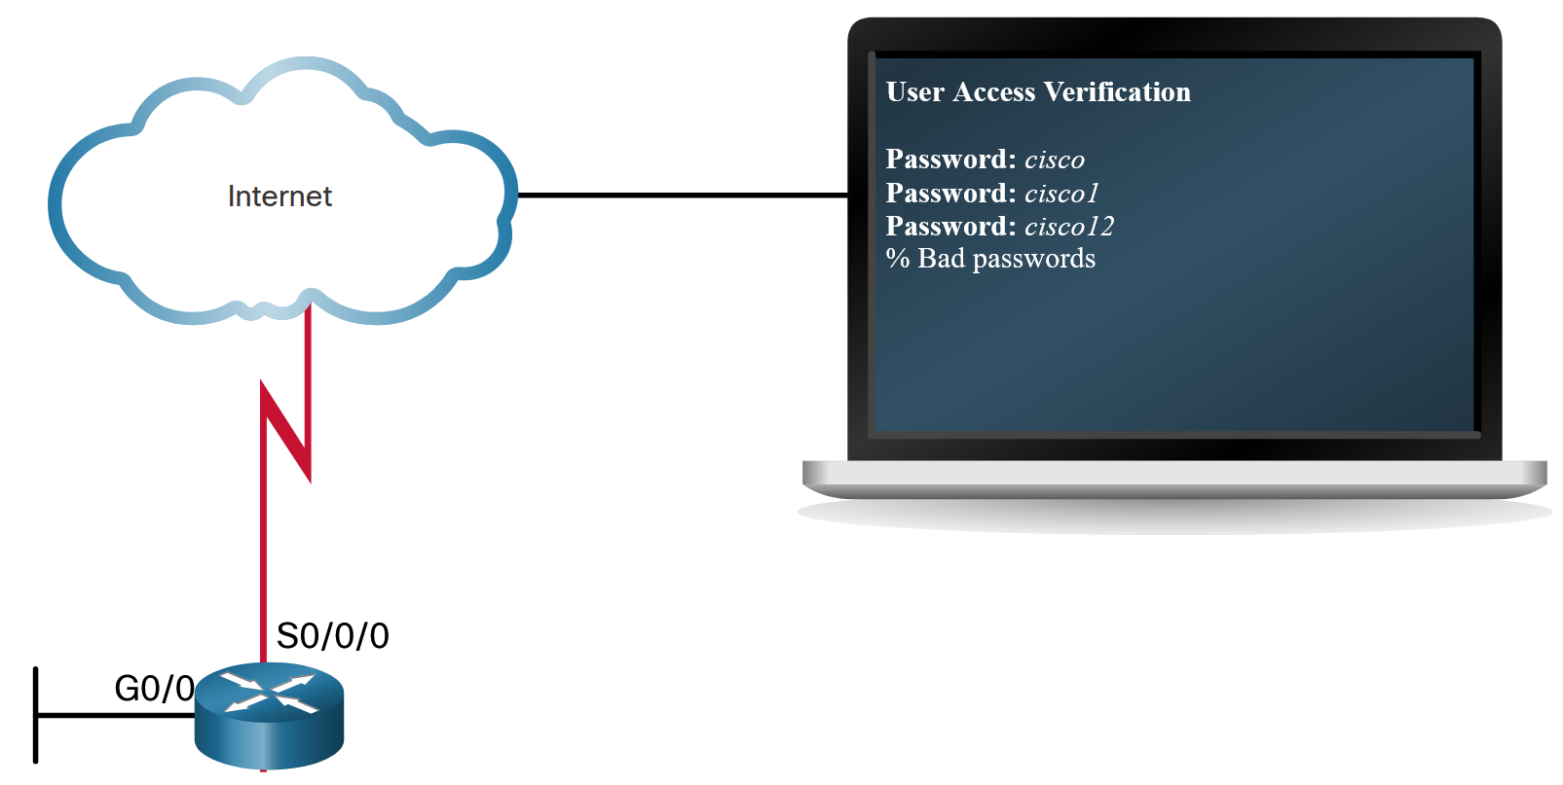
AAA Characteristics
Authentication without AAA
The simplest method of remote access authentication is to configure a login and password combination on console, vty lines, and aux ports, as shown in the figure.
This method provides no accountability. Anyone with the password can gain entry to the device and alter the configuration.
SSH is a more secure form of remote access. It requires both a username and a password, both of which are encrypted during transmissions. The local database method has some limitations. The user accounts must be configured locally on each device.
Notes:
7: Authentication, Authorization, and Accounting (AAA) 7.1: AAA Characteristics 7.1.1: Authentication without AAA

Slide 5
AAA Characteristics
AAA Components
Network and administrative AAA security in the Cisco environment has three functional components:
Authentication - Users and administrators must prove their identity before accessing the network and network resources. Authentication can be established using username and password combinations, challenge and response questions, token cards, and other methods. For example: “I am user ‘student’ and I know the password to prove it.”
Authorization - After the user is authenticated, authorization services determine which resources the user can access and which operations the user is allowed to perform. An example is “User ‘student’ can access host serverXYZ using SSH only.”
Accounting and auditing - Accounting records what the user does, including what is accessed, the amount of time the resource is accessed, and any changes that were made. Accounting keeps track of how network resources are used. An example is "User 'student' accessed host serverXYZ using SSH for 15 minutes."
Notes:
7: Authentication, Authorization, and Accounting (AAA) 7.1: AAA Characteristics 7.1.2: AAA Components

Slide 6
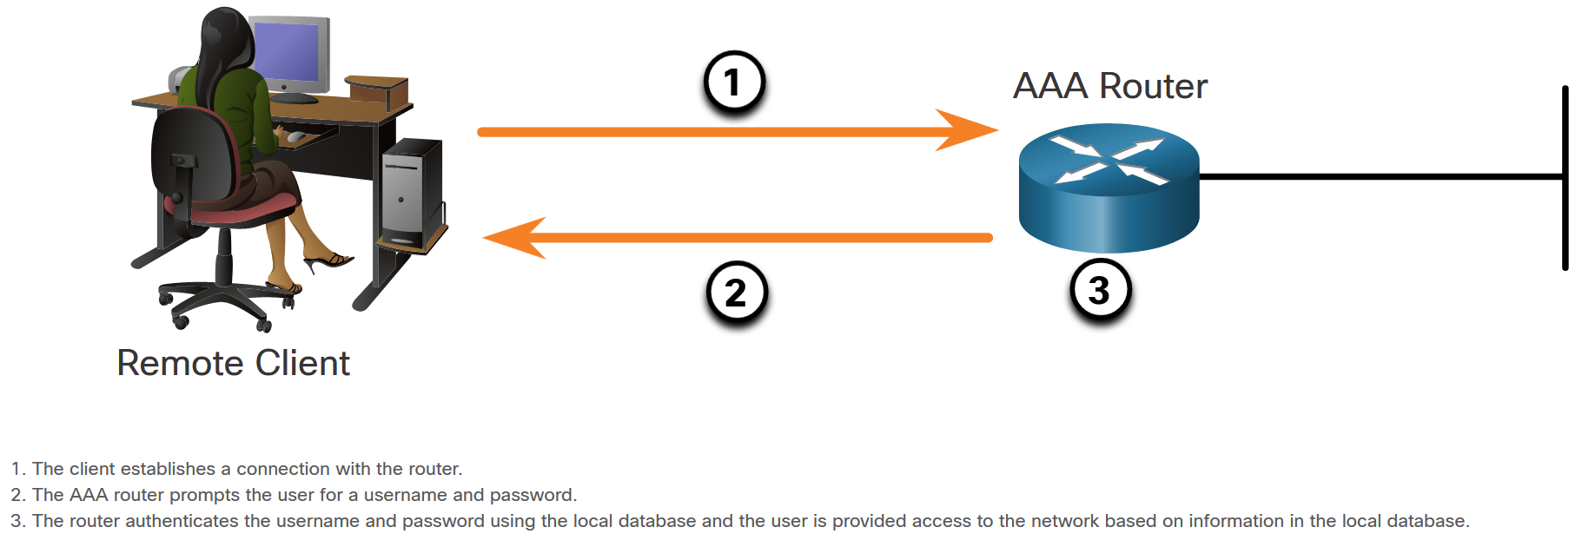
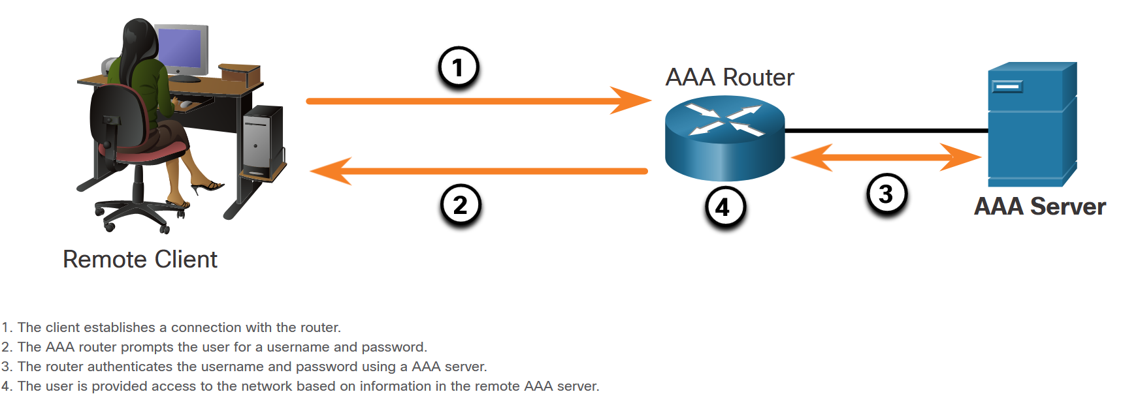
AAA Characteristics
Authentication Modes
Cisco provides two common methods of implementing AAA services:
Local AAA Authentication -Local AAA uses a local database for authentication. This method is sometimes known as self-contained authentication. In this course, it will be referred to as local AAA authentication.
Server-Based AAA Authentication - With the server-based method, the router accesses a central AAA server, such as the Cisco Secure Access Control System (ACS) for Windows, which is shown in the figure. The central AAA server contains the usernames and password for all users. The router uses either the Remote Authentication Dial-In User Service (RADIUS) or Terminal Access Controller Access Control System (TACACS+) protocols to communicate with the AAA server.
Notes:
7: Authentication, Authorization, and Accounting (AAA) 7.1: AAA Characteristics 7.1.3: Authentication Modes

Slide 7
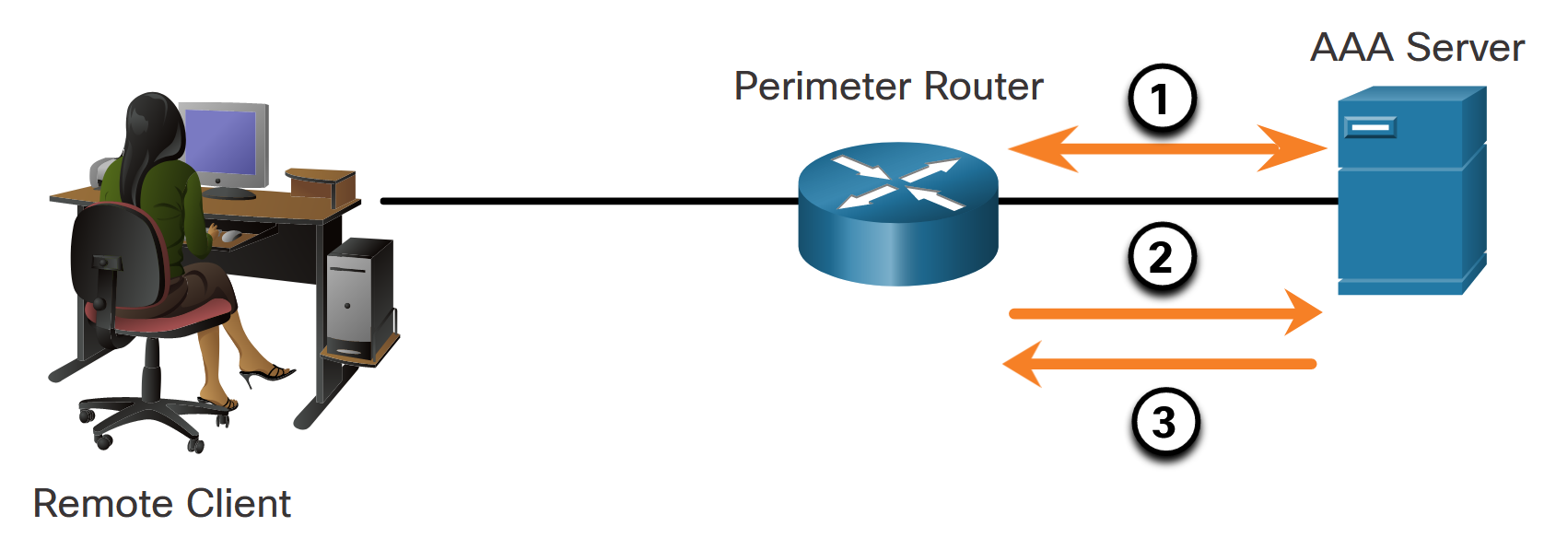
AAA Characteristics
Authorization
After users are successfully authenticated against the selected AAA data source, either local or server-based, they are then authorized for specific network resources, as shown in the figure.
Notes:
7: Authentication, Authorization, and Accounting (AAA) 7.1: AAA Characteristics 7.1.4: Authorization

Slide 8
AAA Characteristics
Accounting
Accounting is implemented using a AAA server. This service reports usage statistics back to the ACS server. These statistics can be extracted to create detailed reports about the configuration of the network.
The types of accounting information that can be collected are as follows:
Network accounting
Connection accounting
EXEC accounting
System accounting
Command accounting
Notes:
7: Authentication, Authorization, and Accounting (AAA) 7.1: AAA Characteristics 7.1.5: Accounting
7.1.6: Check Your Understanding - Identify the Characteristics of AAA

Slide 9
7.2 Configure Local AAA Authentication
Notes:
7: Authentication, Authorization, and Accounting (AAA) 7.2: Configure Local AAA Authentication

Slide 10
Configure Local AAA Authentication
Authenticate Administrative Access
The Local AAA Authentication method is similar to using the login local command with one exception. AAA also provides a way to configure backup methods of authentication.
Configuring local AAA services to authenticate administrator access requires a few basic steps:
Step 1. Add usernames and passwords to the local router database for users that need administrative access to the router.
Step 2. Enable AAA globally on the router.
Step 3. Configure AAA parameters on the router.
Step 4. Confirm and troubleshoot the AAA configuration.
Notes:
7: Authentication, Authorization, and Accounting (AAA) 7.2: Configure Local AAA Authentication 7.2.1: Authenticate Administrative Access

Slide 11
Configure Local AAA Authentication
Authentication Methods
Use the aaa authentication login command, shown below, to enable authentication of the console, aux, and vty lines. The default keyword applies authentication to all lines. Alternatively, a custom authentication method can be configured using a list-name.
Command | Description
default | Uses the listed authentication methods that follow this keyword as the default list of methods when a user logs in.
list-name | Character string used to name the list of authentication methods activated when a user logs in.
method1...[method4] | Identifies the list of methods that the AAA authentication process will query in the given sequence. At least one method must be specified. A maximum of four methods may be specified.
Notes:
7: Authentication, Authorization, and Accounting (AAA) 7.2: Configure Local AAA Authentication 7.2.2: Authentication Methods

Slide 12
Configure Local AAA Authentication
Authentication Methods (Cont.)
Up to four methods can be defined to authenticate users, providing fallback methods should one method not be available. To enable local authentication using a preconfigured local database, use the keyword local or local-case. To specify that a user can authenticate using the enable password, use the enable keyword.
The table displays common methods that can be specified.
Method Type Keywords | Description
enable | Uses the enable password for authentication.
local | Uses the local username database for authentication.
local-case | Uses case-sensitive local username authentication.
none | Uses no authentication.
group radius | Uses the list of all RADIUS servers for authentication.
group tacacs+ | Uses the list of all TACACS+ servers for authentication.
group group-name | Uses a subset of RADIUS or TACACS+ servers for authentication as defined by the aaa group server radius or aaa group server tacacs+ command.
Notes:
7: Authentication, Authorization, and Accounting (AAA) 7.2: Configure Local AAA Authentication 7.2.2: Authentication Methods

Slide 13
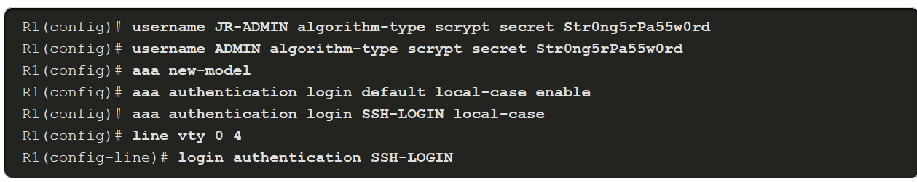
Configure Local AAA Authentication
Default and Named Methods
For flexibility, different method lists can be applied to different interfaces and lines using the aaa authentication login list-name command.
The named list must be explicitly enabled on the line using the login authentication line configuration command. If a line has a custom authentication method list applied to it, that method list overrides the default method list for that interface.
When a custom authentication method list is applied to an interface, it is possible to return to the default method list by using the no authentication login command.
Notes:
7: Authentication, Authorization, and Accounting (AAA) 7.2: Configure Local AAA Authentication 7.2.3: Default and Named Methods

Slide 14
Configure Local AAA Authentication
Fine-Tuning the Authentication Configuration
Additional security can be implemented on the line using the aaa local authentication attempts max-fail global configuration mode command. This command secures AAA user accounts by locking out accounts that have excessive failed attempts.
Command | Description
number-of-unsuccessful-attempts | Number of unsuccessful authentication attempts before a connection is dropped and the user account is locked.
The locked out user account remains locked until it is manually cleared by an administrator using the clear aaa local user lockout privileged EXEC mode command.
To display the attributes that are collected for one AAA session, use the show aaa user command in privileged EXEC mode.
Notes:
7: Authentication, Authorization, and Accounting (AAA) 7.2: Configure Local AAA Authentication 7.2.4: Fine-Tuning the Authentication Configuration

Slide 15
Configure Local AAA Authentication
Lab - Configure Local AAA Authentication
In this lab, you will complete the following objectives:
Part 1: Configure Basic Device Settings
Part 2: Configure Local Authentication
Part 3: Configure Local Authentication using AAA.
Notes:
7: Authentication, Authorization, and Accounting (AAA) 7.2: Configure Local AAA Authentication 7.2.5: Lab - Configure Local AAA Authentication

Slide 16
Configure Local AAA Authentication
Packet Tracer - Configure Local AAA for Console and VTY Access
In this PT activity, you will configure AAA local authentication on the console line and VTY lines with SSH.
Notes:
7: Authentication, Authorization, and Accounting (AAA) 7.2: Configure Local AAA Authentication 7.2.6: Packet Tracer - Configure Local AAA for Console and VTY Access

Slide 17
7.3 Server-Based AAA Characteristics and Protocols
Notes:
7: Authentication, Authorization, and Accounting (AAA) 7.3: Server-Based AAA Characteristics and Protocols

Slide 18
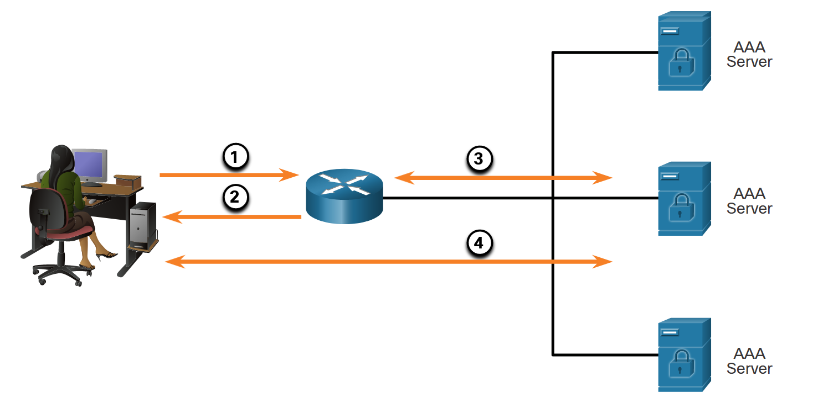
Server-Based AAA Characteristics and Protocols
Compare Local AAA and Server-Based AAA Implementations
One or more AAA servers can be used to manage the user and administrative access needs for an entire corporate network. AAA server software can create a central user and administrative access database to which all devices in the network can refer. It may also work with many external databases, including Active Directory and Lightweight Directory Access Protocol (LDAP). These databases store user account information and passwords, allowing for central administration of user accounts. For increased redundancy, multiple servers can be implemented.
The figure shows the process of authenticating router administrator users.
Notes:
7: Authentication, Authorization, and Accounting (AAA) 7.3: Server-Based AAA Characteristics and Protocols 7.3.1: Compare Local AAA and Server-Based AAA Implementations

Slide 19
Server-Based AAA Characteristics and Protocols
Cisco Identity Services Engine (ISE)
Cisco Identity Services Engine (ISE) is an identity and access control policy platform that enables enterprises to enforce compliance, enhance infrastructure security, and streamline their service operations. Cisco ISE combines policy definition, control, and reporting in one appliance. Cisco ISE defines fair access policies and enforces compliance for all end devices including BYOD.
Several features of ISE are:
Asset Visibility
Posture assessment
Segmentation
Guest management and secure wireless
Threat Containment
Notes:
7: Authentication, Authorization, and Accounting (AAA) 7.3: Server-Based AAA Characteristics and Protocols 7.3.2: Cisco Identity Services Engine (ISE)

Slide 20
Server-Based AAA Characteristics and Protocols
The TACACS+ and RADIUS Protocols
TACACS+ and RADIUS are both authentication protocols that are used to communicate with AAA servers. As shown in the table, each supports different capabilities and functionality.
 | TACACS+ | RADIUS
Functionality | Separates AAA according to the AAA architecture, allowing modularity of the security server implementation | Combines authentication and authorization but separates accounting, allowing less flexibility in implementation than TACACS+
Standard | Mostly Cisco supported | Open/RFC standard
Transport Protocol | TCP | UDP
CHAP | Bidirectional challenge and response as used in Challenge Handshake Authentication Protocol (CHAP) | Unidirectional challenge and response from the RADIUS security server to the RADIUS client
Confidentiality | Entire packet encrypted | Password encrypted
Customization | Provides authorization of router commands on a per-user or per-group basis | Has no option to authorize router commands on a per-user or per-group basis
Accounting | Limited | Extensive
Notes:
7: Authentication, Authorization, and Accounting (AAA) 7.3: Server-Based AAA Characteristics and Protocols 7.3.3: The TACACS+ and RADIUS Protocols

Slide 21
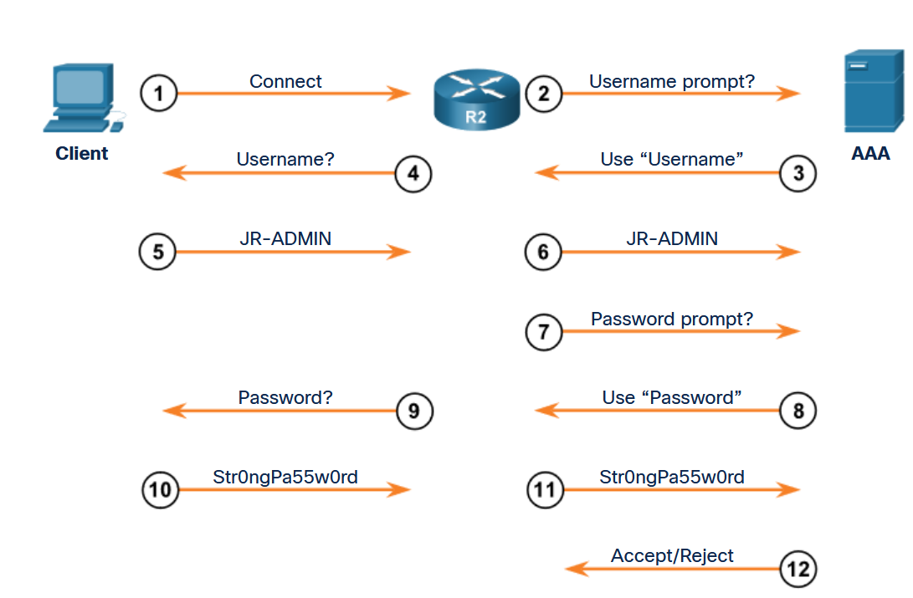
Server-Based AAA Characteristics and Protocols
TACACS+ Authentication
TACACS+ is a Cisco enhancement to the original TACACS protocol.
TACACS+ provides separate AAA services. It is possible to use TACACS+ for authorization and accounting while using another method of authentication.
The TACACS+ authentication process is shown in the figure.
Notes:
7: Authentication, Authorization, and Accounting (AAA) 7.3: Server-Based AAA Characteristics and Protocols 7.3.4: TACACS+ Authentication

Slide 22
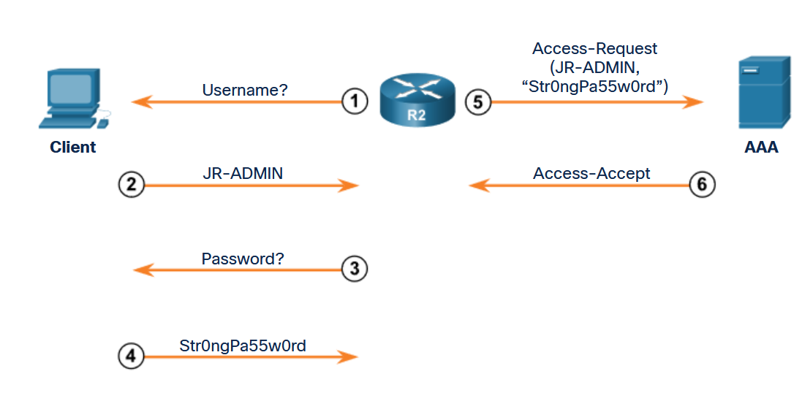
Server-Based AAA Characteristics and Protocols
RADIUS Authentication
RADIUS is an open IETF standard AAA protocol for applications such as network access or IP mobility. RADIUS works in both local and roaming situations and is commonly used for accounting purposes.
The RADIUS protocol hides passwords during transmission, even with the Password Authentication Protocol (PAP), using a rather complex operation that involves Message Digest 5 (MD5) hashing and a shared secret. However, the rest of the packet is sent in plaintext.
RADIUS combines authentication and authorization as one process.
The figure shows the RADIUS authentication process.
Notes:
7: Authentication, Authorization, and Accounting (AAA) 7.3: Server-Based AAA Characteristics and Protocols 7.3.5: RADIUS Authentication
7.3.6: Check Your Understanding - Identify the AAA Communication Protocol

Slide 23
7.4 Configure Server-Based Authentication
Notes:
7: Authentication, Authorization, and Accounting (AAA) 7.4: Configure Server-Based Authentication

Slide 24
Configure Server-Based Authentication
Steps to Configure Server-Based AAA Authentication
There are four basic steps to configure server-based authentication:
Step 1. Globally enable AAA to allow the use of all AAA elements. This step is a prerequisite for all other AAA commands.
Step 2. Specify the server that will provide AAA services for the router. This can be a TACACS+ or RADIUS server.
Step 3. Configure the encryption key needed to encrypt the data transfer between the network device and AAA server.
Step 4. Configure the AAA authentication method list to refer to the TACACS+ or RADIUS server. For redundancy, it is possible to configure more than one server.
Notes:
7: Authentication, Authorization, and Accounting (AAA) 7.4: Configure Server-Based Authentication 7.4.1: Steps to Configure Server-Based AAA Authentication

Slide 25
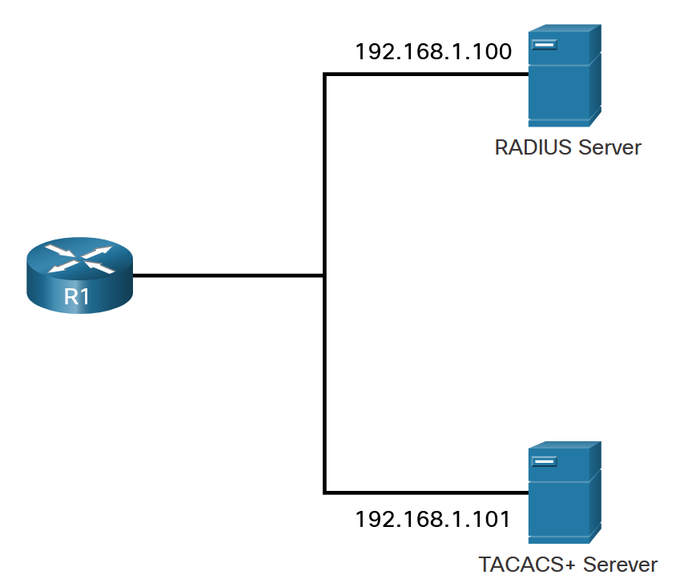
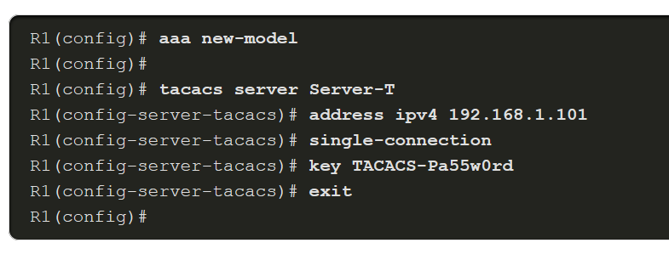
Configure Server-Based Authentication
Configure TACACS+ Servers
To configure a TACACS+ server, globally enable AAA using the aaa new-model command.
Use the tacacs server name command.
In TACACS+ server configuration mode, configure the IPv4 address of the TACACS+ server using the address ipv4 command. The address ipv4 command allows the option to modify the authentication port and the accounting port.
Use the single-connection command to enhance TCP performance. If required, multiple TACACS+ servers can be identified by entering their respective IPv4 addresses using the tacacs server name command.
The key key command is used to configure the shared secret key to encrypt the data transfer between the TACACS+ server and AAA-enabled router.
Notes:
7: Authentication, Authorization, and Accounting (AAA) 7.4: Configure Server-Based Authentication 7.4.2: Configure TACACS+ Servers

Slide 26
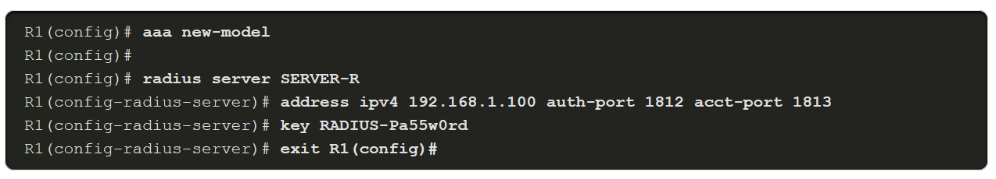
Configure Server-Based Authentication
Configure RADIUS Servers
To configure a RADIUS server, use the radius server name command.
If required, multiple RADIUS servers can be identified by entering a radius server name command for each server.
In RADIUS server configuration mode, configure the IPv4 address of the RADIUS server using the address ipv4 ipv4-address command.
To configure the shared secret key for encrypting the password, use the key command.
Notes:
7: Authentication, Authorization, and Accounting (AAA) 7.4: Configure Server-Based Authentication 7.4.3: Configure RADIUS Servers

Slide 27
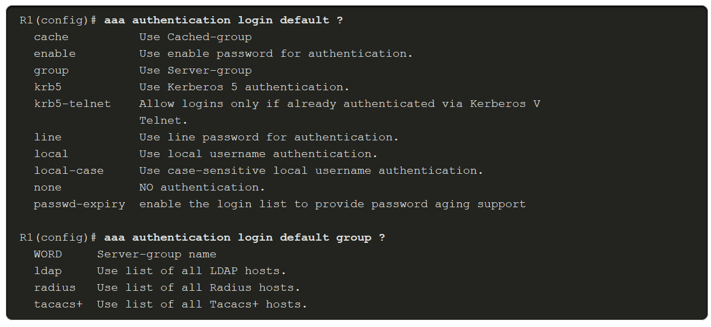
Configure Server-Based Authentication
Authenticate to the AAA Server Configuration Commands
When the AAA security servers have been identified, the servers must be included in the method list of the aaa authentication login command. AAA servers are identified using the group tacacs+ or group radius keywords. Refer to the figure to see command syntax options available with the aaa authentication login command.
Notes:
7: Authentication, Authorization, and Accounting (AAA) 7.4: Configure Server-Based Authentication 7.4.4: Authenticate to the AAA Server Configuration Commands
7.4.5: Syntax Checker - Configure Server-Based AAA Authentication

Slide 28
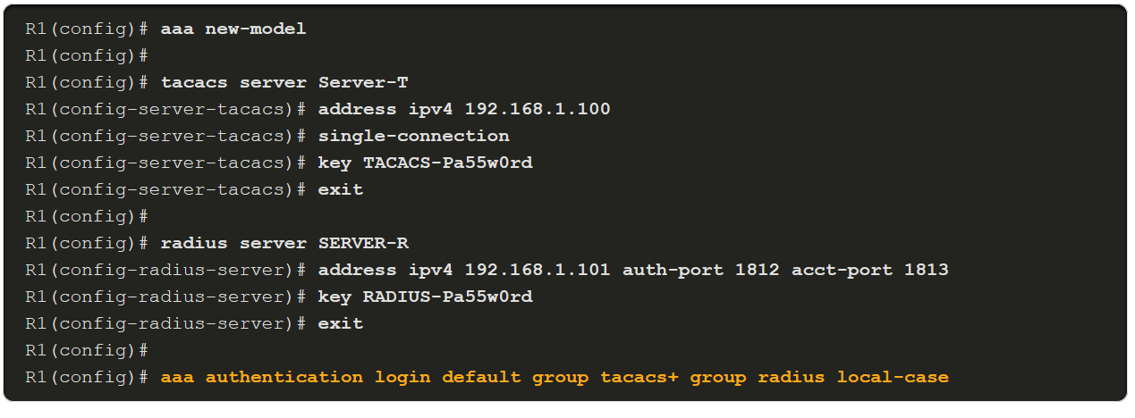
Configure Server-Based Authentication
Authenticate to the AAA Server Configuration Commands (Cont.)
To configure a method list for the default login to authenticate first using a TACACS+ server, second with a RADIUS server, and finally with a local username database, specify the order with the aaa authentication login default command, as highlighted in the example.
Notes:
7: Authentication, Authorization, and Accounting (AAA) 7.4: Configure Server-Based Authentication 7.4.4: Authenticate to the AAA Server Configuration Commands
7.4.5: Syntax Checker - Configure Server-Based AAA Authentication

Slide 29
Configure Server-Based Authentication
Video Demonstration - Configure a Cisco Router to Access a AAA RADIUS Server
This video demonstrates how to configure a Cisco router to access a AAA RADIUS server by completing the following:
Step 1. Create users on the RADIUS server
Step 2. Set a secret key on the RADIUS server
Step 3. Verify port 1812 for the RADIUS authentication port and 1813 for the RADIUS accounting port
Step 4. Set up SSH on the router for remote access
Step 5. Set up a local user on the router in case of RADIUS server failure
Step 6. Enable AAA authentication on the router
Step 7. Set AAA authentication login method lists
Step 8. Enable the router to use the RADIUS server for authentication by configuring the following on the router:
RADIUS server name
RADIUS server IP address, authentication port 1812, and accounting port 1813
shared secret key
Step 9. Configure the console line and specify the AAA login authentication method list to use
Step 10. Configure the VTY lines for SSH and specify the AAA login authentication method list to use
Step 11. Test and verify
Notes:
7: Authentication, Authorization, and Accounting (AAA) 7.4: Configure Server-Based Authentication 7.4.6: Video Demonstration - Configure a Cisco Router to Access a AAA RADIUS Server

Slide 30
Configure Server-Based Authentication
Lab – Install the Virtual Machine
In this lab, you will install the virtual machine.
Notes:
7: Authentication, Authorization, and Accounting (AAA) 7.4: Configure Server-Based Authentication 7.4.7: Lab – Install the Virtual Machine

Slide 31
Configure Server-Based Authentication
Lab -Configure Server-Based Authentication with RADIUS
In this lab, you will complete the following objective:
Configure Centralized Authentication Using AAA and RADIUS
Notes:
7: Authentication, Authorization, and Accounting (AAA) 7.4: Configure Server-Based Authentication 7.4.8: Lab -Configure Server-Based Authentication with RADIUS

Slide 32
Configure Server-Based Authentication
Packet Tracer -Configure Server-Based Authentication with TACACS+ and RADIUS
In this Packet Tracer activity, you will complete the following objectives:
Configure server-based AAA authentication using TACACS+.
Verify server-based AAA authentication from the PC-B client.
Configure server-based AAA authentication using RADIUS.
Verify server-based AAA authentication from the PC-C client.
Notes:
7: Authentication, Authorization, and Accounting (AAA) 7.4: Configure Server-Based Authentication 7.4.9: Packet Tracer -Configure Server-Based Authentication with TACACS+ and RADIUS

Slide 33
7.5 Configure Server-Based Authorization and Accounting
Notes:
7: Authentication, Authorization, and Accounting (AAA) 7.5: Configure Server-Based Authorization and Accounting

Slide 34
Configure Server-Based Authorization and Accounting
Introduction to Server-Based AAA Authorization
Authorization is concerned with allowing and disallowing authenticated users access to functions of the network device interface. The TACACS+ protocol allows the separation of authentication from authorization. A router can be configured to restrict the user to performing only certain functions after successful authentication. Keep in mind that RADIUS does not separate the authentication from the authorization process.
Another important aspect of authorization is the ability to control user access to specific services.
By default, TACACS+ establishes a new TCP session for every authorization request, which can lead to delays when users enter commands. To improve performance, AAA supports persistent TCP sessions that are configured with the single-connection tacacs server configuration mode command.
Notes:
7: Authentication, Authorization, and Accounting (AAA) 7.5: Configure Server-Based Authorization and Accounting 7.5.1: Introduction to Server-Based AAA Authorization

Slide 35
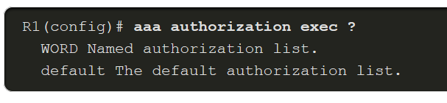
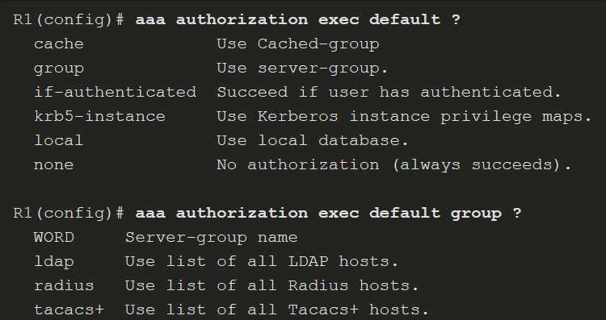
Configure Server-Based Authorization and Accounting
AAA Authorization Configuration
To configure authorization, use the aaa authorization command, as shown in the examples below. The authorization type can specify the types of commands or services:
network - for network services such as PPP and SLIP
exec - for User EXEC terminal sessions
commands level - command authorization attempts authorization for all EXEC mode commands, including global configuration commands, associated with a specific privilege level
Notes:
7: Authentication, Authorization, and Accounting (AAA) 7.5: Configure Server-Based Authorization and Accounting 7.5.2: AAA Authorization Configuration

Slide 36
Configure Server-Based Authorization and Accounting
Introduction to Server-Based AAA Accounting
AAA accounting enables usage tracking.
When accounting is configured on a AAA server it functions as a central repository for accounting information.
Each session that is established through Cisco Secure ACS can be fully accounted for and stored on the server.
Like authentication and authorization method lists, method lists for accounting define the way accounting is performed and the sequence in which these methods are performed. After it is enabled, the default accounting method list is automatically applied to all interfaces, except those that have a user-defined, or custom, accounting method list that has been explicitly defined.
Notes:
7: Authentication, Authorization, and Accounting (AAA) 7.5: Configure Server-Based Authorization and Accounting 7.5.3: Introduction to Server-Based AAA Accounting

Slide 37
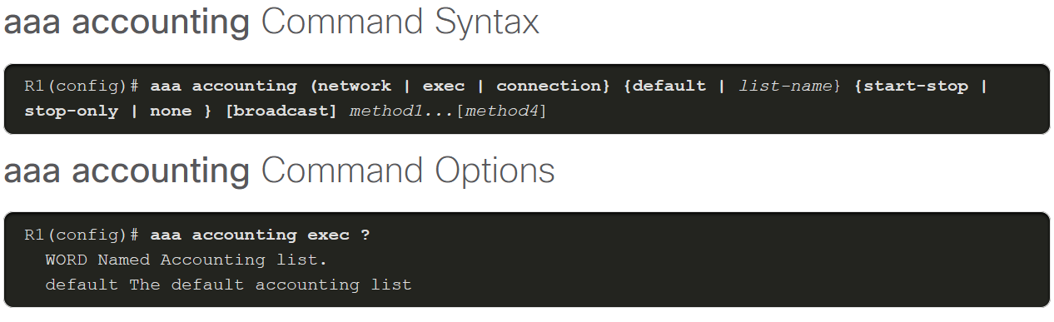
Configure Server-Based Authorization and Accounting
AAA Accounting Configuration
To configure AAA accounting, use the aaa accounting command that is shown in the figure.
The following three parameters are commonly used aaa accounting keywords:
network - Runs accounting for all network-related service requests, including PPP.
exec - Runs accounting for the EXEC shell session.
connection - Runs accounting on all outbound connections such as SSH and Telnet.
Notes:
7: Authentication, Authorization, and Accounting (AAA) 7.5: Configure Server-Based Authorization and Accounting 7.5.4: AAA Accounting Configuration

Slide 38
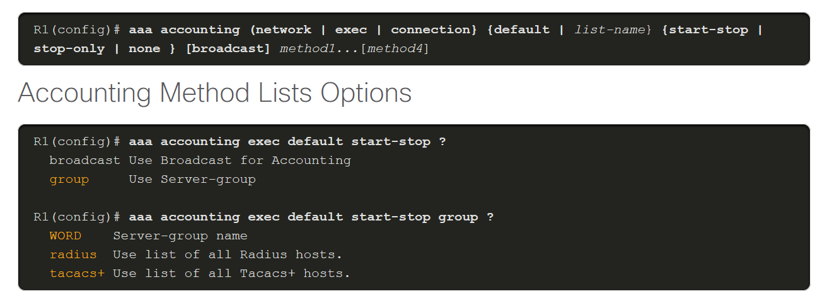
Configure Server-Based Authorization and Accounting
AAA Accounting Configuration (Cont.)
As with AAA authentication, either the keyword default or a list-name can be used. Next, the record type, or trigger, is configured. The trigger specifies what actions cause accounting records to be updated.
Possible triggers include:
start-stop - Sends a "start" accounting notice at the beginning of a process and a "stop" accounting notice at the end of a process.
stop-only - Sends a "stop" accounting record for all cases including authentication failures.
none - Disables accounting services on a line or interface.
The figures show the command syntax and method list options available.
Notes:
7: Authentication, Authorization, and Accounting (AAA) 7.5: Configure Server-Based Authorization and Accounting 7.5.4: AAA Accounting Configuration
7.5.5: Syntax Checker - Configure AAA Accounting

